Slide 1
Spatial Analysis of Benefits of Site Specific Ground Motion Response Analysis
(Research Project No. TRC1901)
Ashraf Elsayed, Ph.D., P.E.
Shahram Pezeshk, Ph.D., P.E., F.ASCE
Nima Nazemi
Ali Farhadi

Slide 2
Motivation
Site-Specific Ground Motion Response Analysis (SSGMRA) may reduce seismic demands in parts of Arkansas which will result in cost saving.

Slide 3
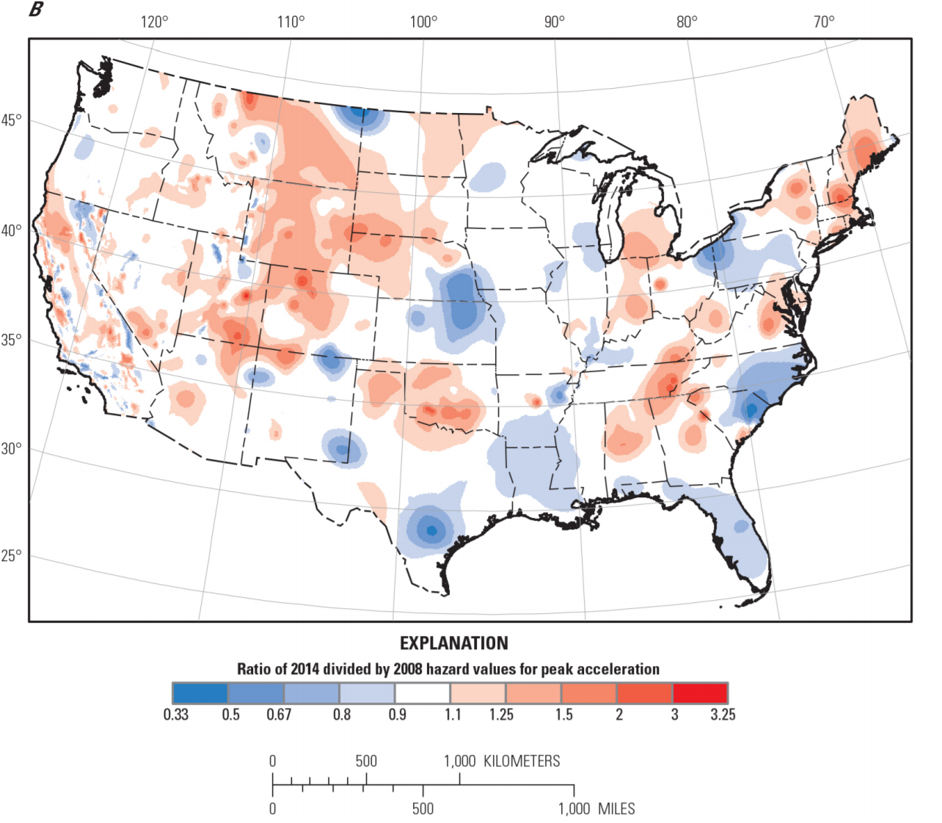
Map comparing change in peak ground acceleration for 2-percent probability of exceedance in 50 years and VS30 site condition of 760 meters per second, ratio between the 2014 and 2008 versions.
(USGS Open-File Report, 2014)

Slide 4
Objectives of TRC1901
OBJECTIVE 1: OBTAINING SITE SPECIFIC SHEAR-WAVE VELCITY PROFILES
OBJECTIVE 2: COLLECT SOIL BORING LOGS
OBJECTIVE 3: PERFORMING SITE-SPECIFC ANALYSIS
OBJECTIVE 4: GROUND SURFACE CONTOUR MAPS
OBJECTIVE 5: DEVELOPING DOCUMENTATIONS AND SPECIFICATIONS FOR SITES THAT NEED SITE-SPECIFC STUDIES TO BE PERFORMED
Notes:
These are the objectives of our proposal.

Slide 5
OBTAINING SITE SPECIFIC SHEAR-WAVE VELCITY PROFILES
  Planning and meeting with ARDOT to determine select 20 sites. (Completed).
  ReMi and MASW measurements at the selected sites. (20 Sites Completed).
  Processing of the MASW data. (in Progress)
  Determination of shear-wave velocity profile. (in Progress)

Slide 6
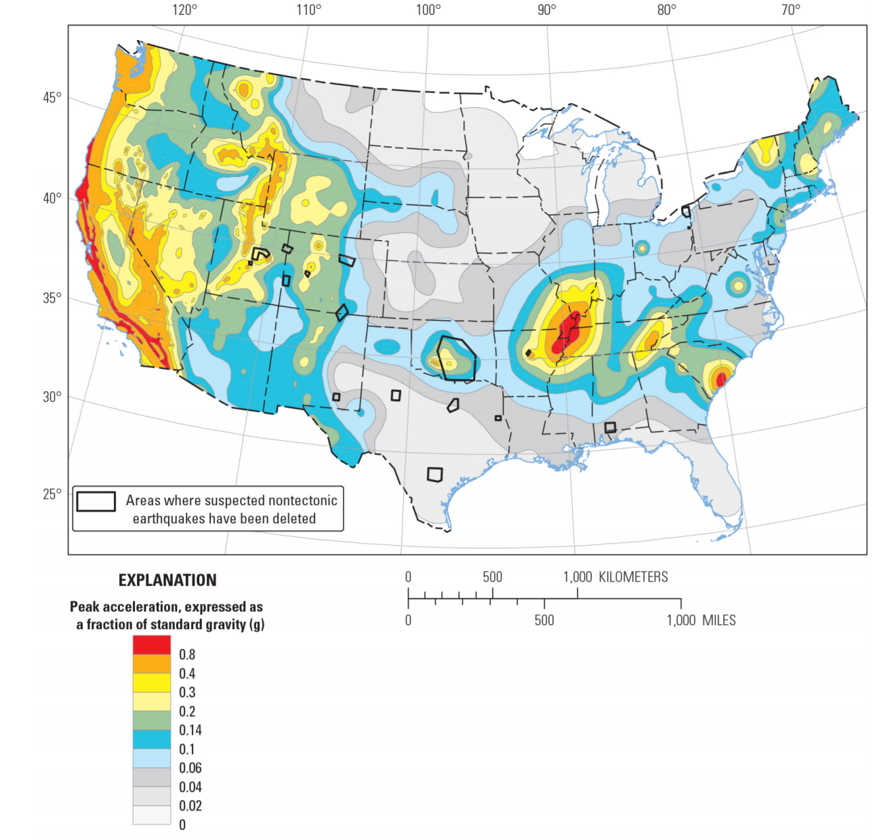
Map showing peak ground acceleration for 2-percent probability of exceedance in 50 years and VS30 site condition of 760 meters per second, 2014 version.
(USGS Open-File Report, 2014)

Slide 7
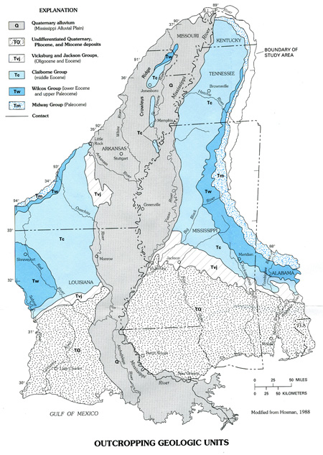
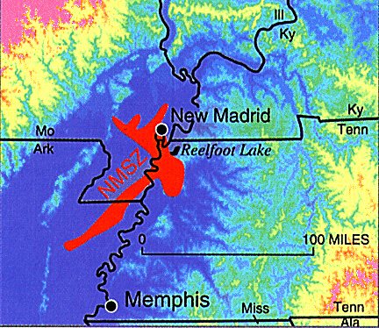
Image adapted from New Madrid Fault Topography
Arthur and Taylor (1998).

Slide 8
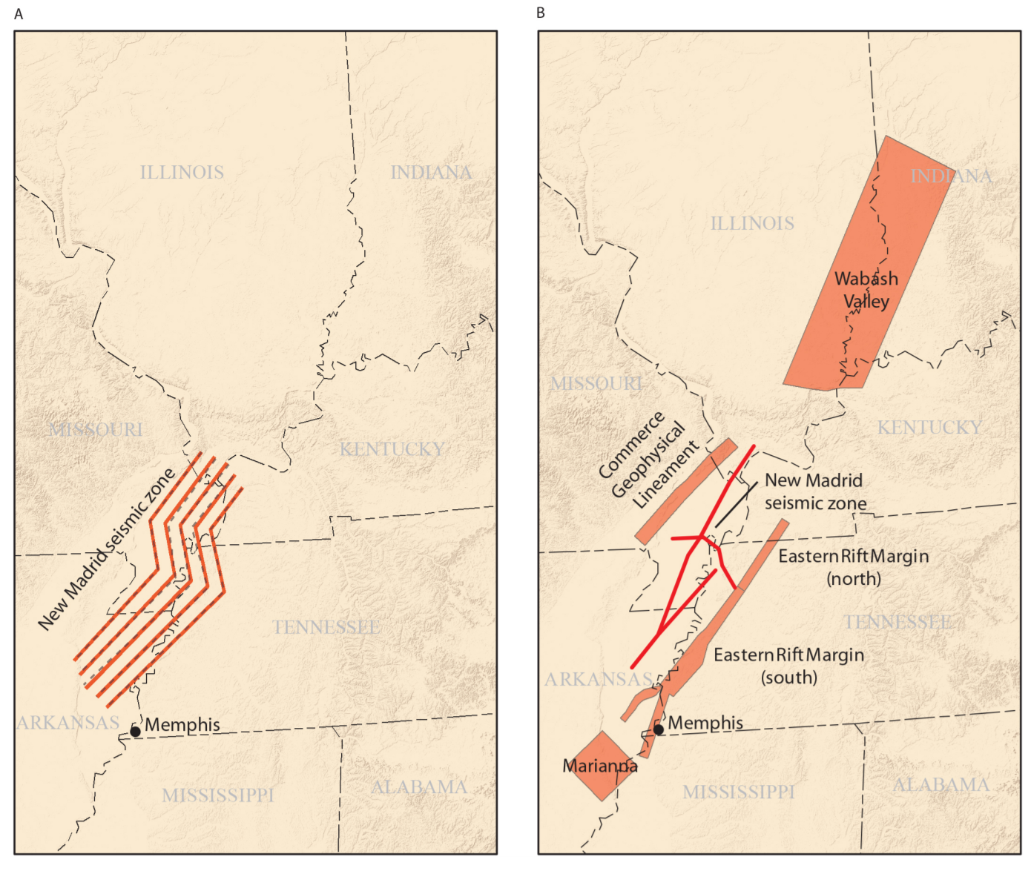
Representations of fault sources near the New Madrid seismic zone. A, USGS representation from the 2008 update (dashed lines) and 2014 update (solid lines) and B, CEUS–SSCn (2012) project representation.
(USGS Open-File Report, 2014)

Slide 9
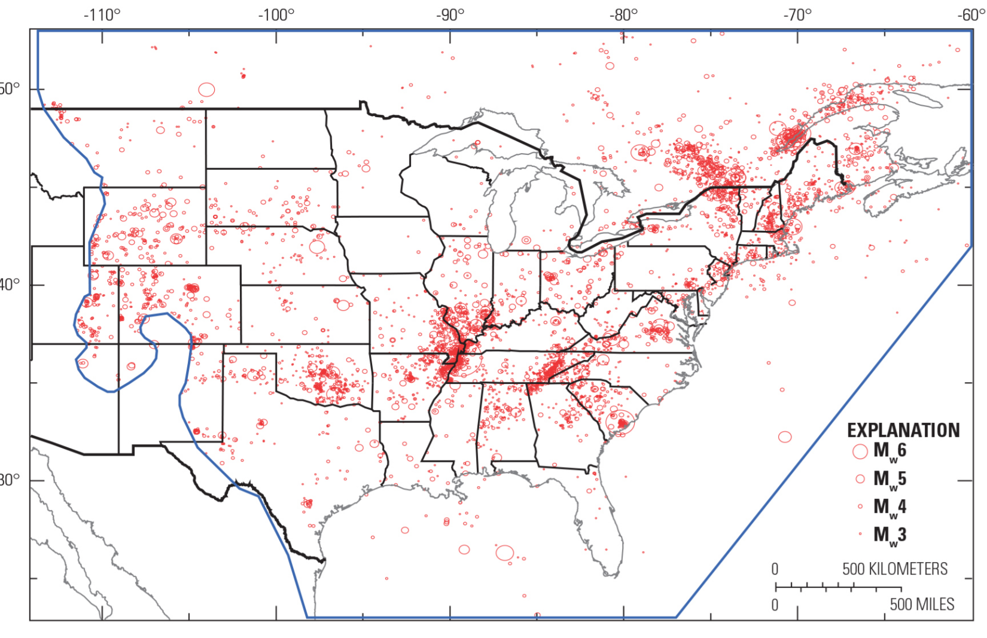
Declustered catalog for the Central and Eastern United States including Mw2.5 and greater earthquakes occurring since 1700, including potentially induced earthquakes.
(USGS Open-File Report, 2014)

Slide 10
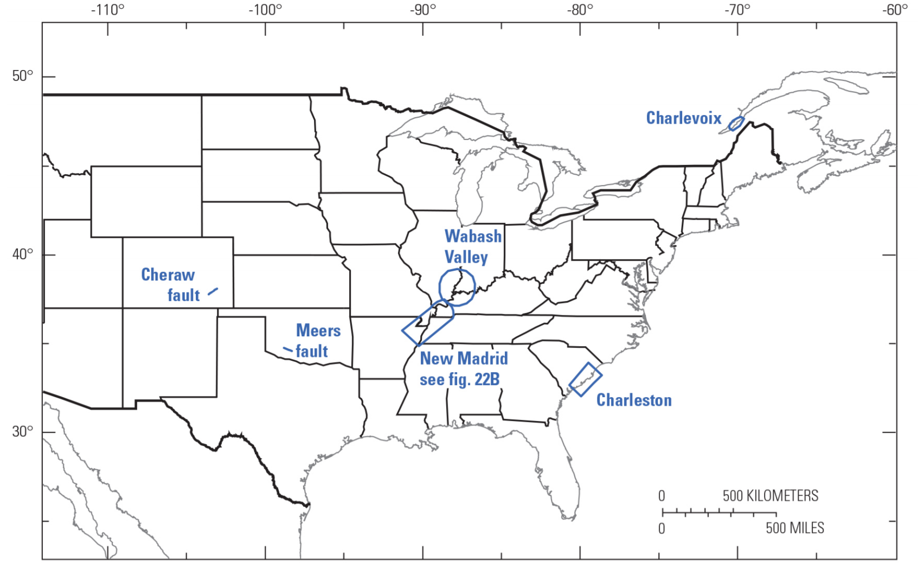
Location of fault sources in the Central and Eastern United States.
(USGS Open-File Report, 2014)

Slide 11
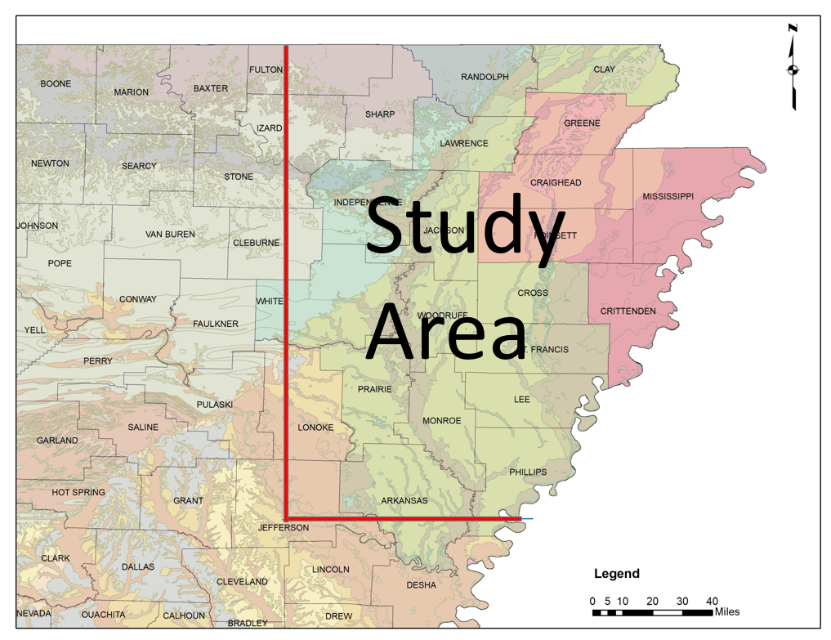
Study Area

Slide 12
Site selection
Geological considerations
Area coverage
Boring log information availability

Slide 13
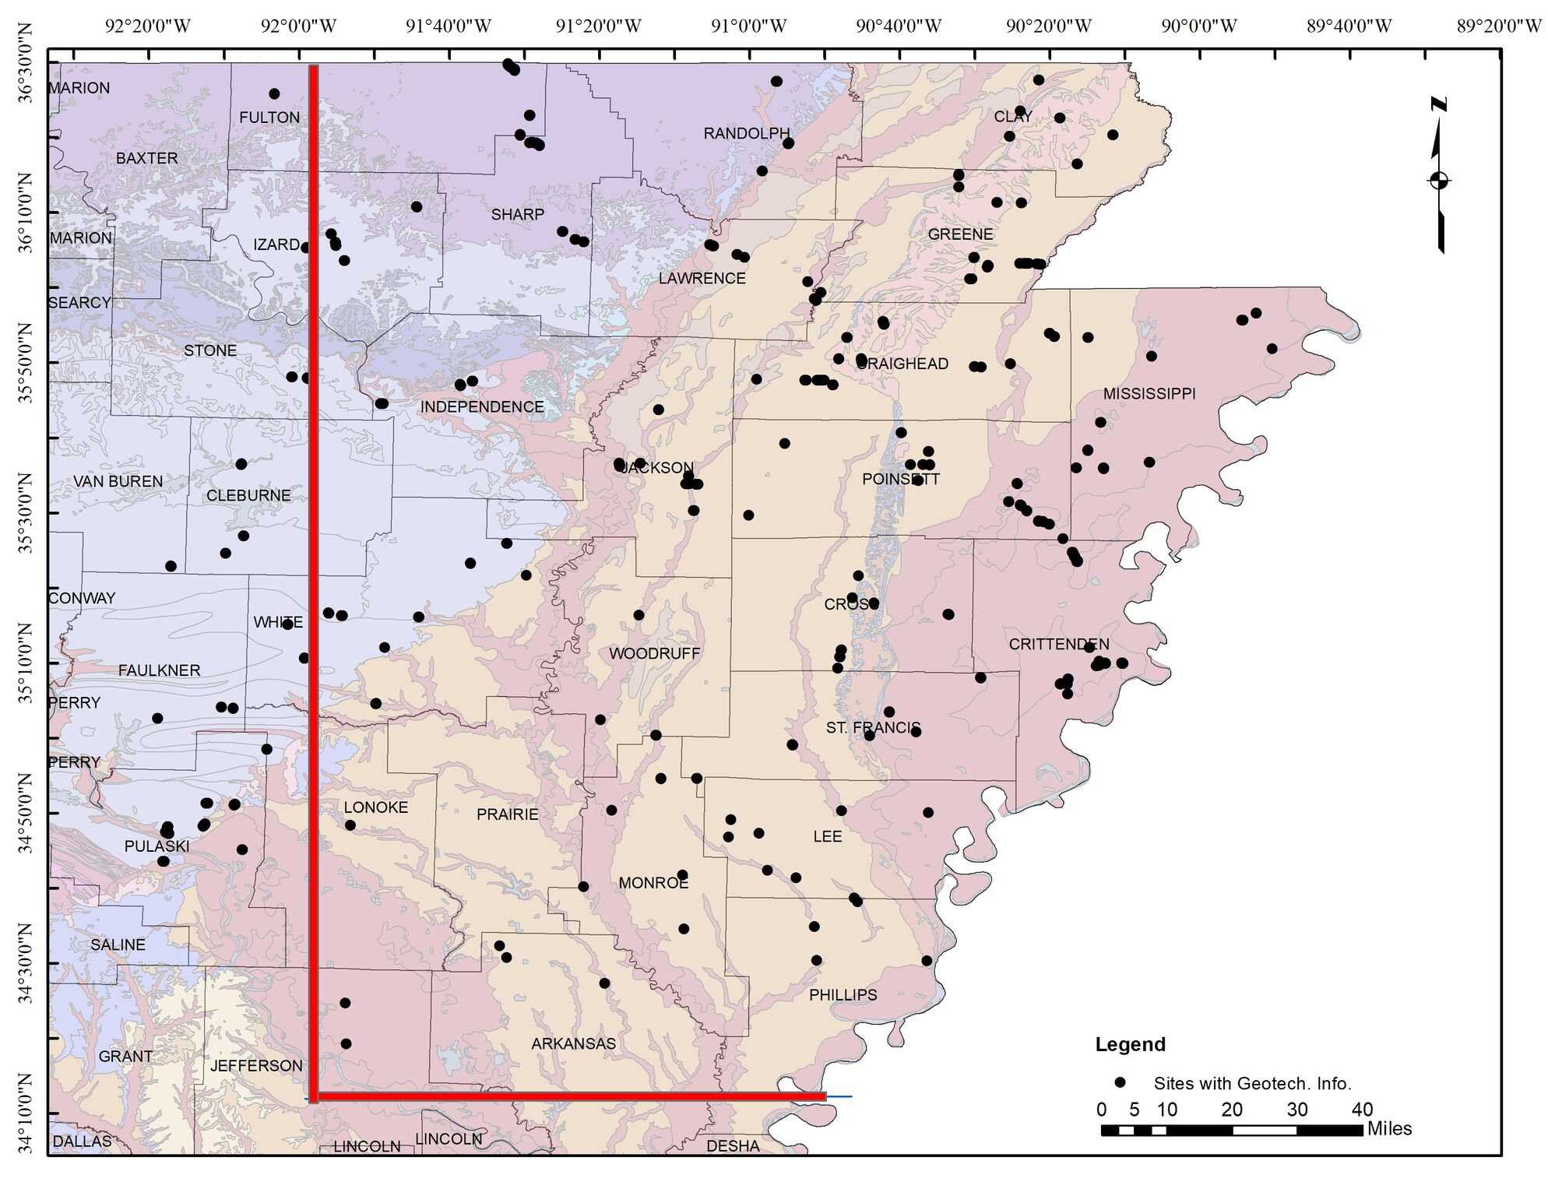

Slide 14
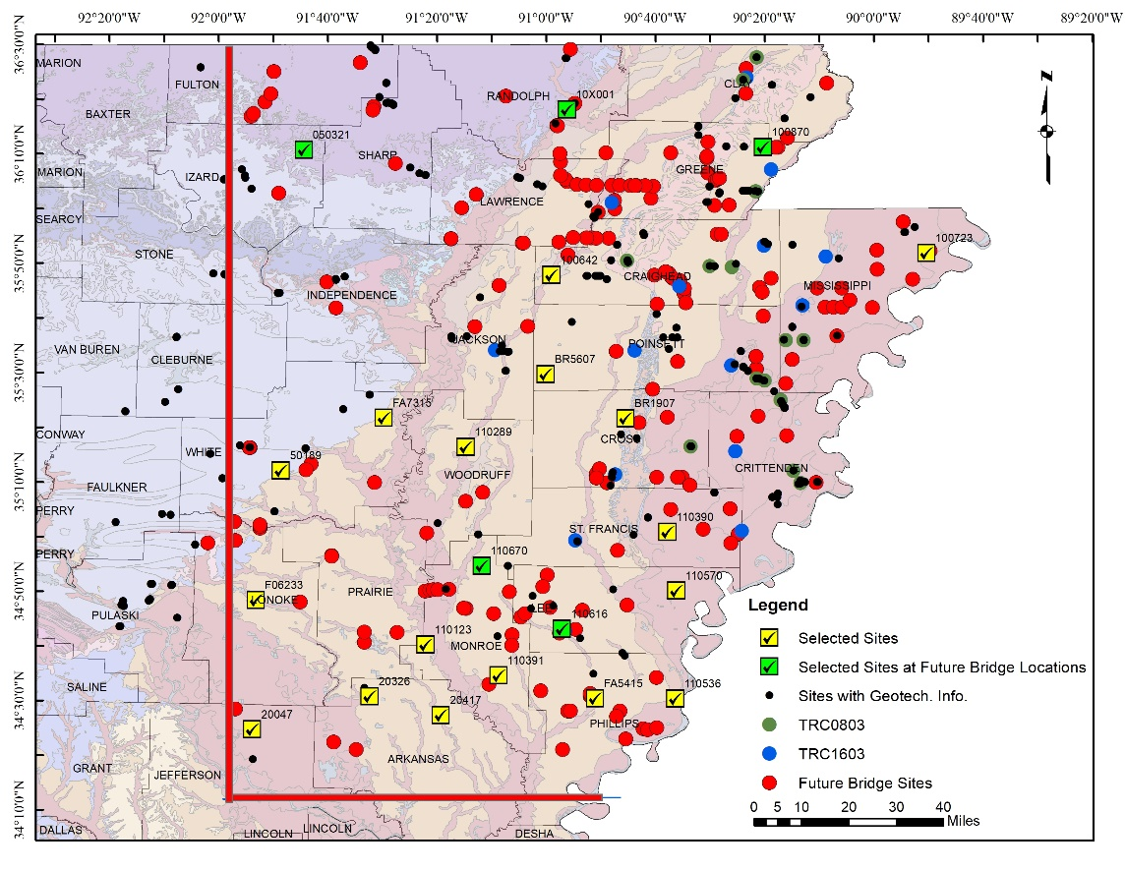
Locations of Proposed Sites, Available Boring Logs, Future Bridge Sites, and Sites Investigated by TRC1603 and TRC0803 Projects

Slide 15
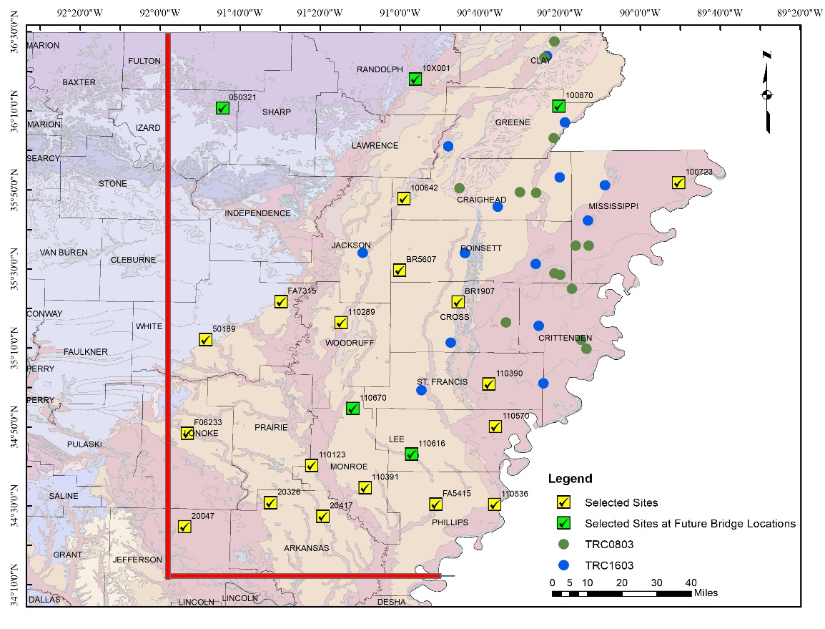
Locations of Proposed Sites and Sites Investigated by TRC1603 and TRC0803 Projects.

Slide 16
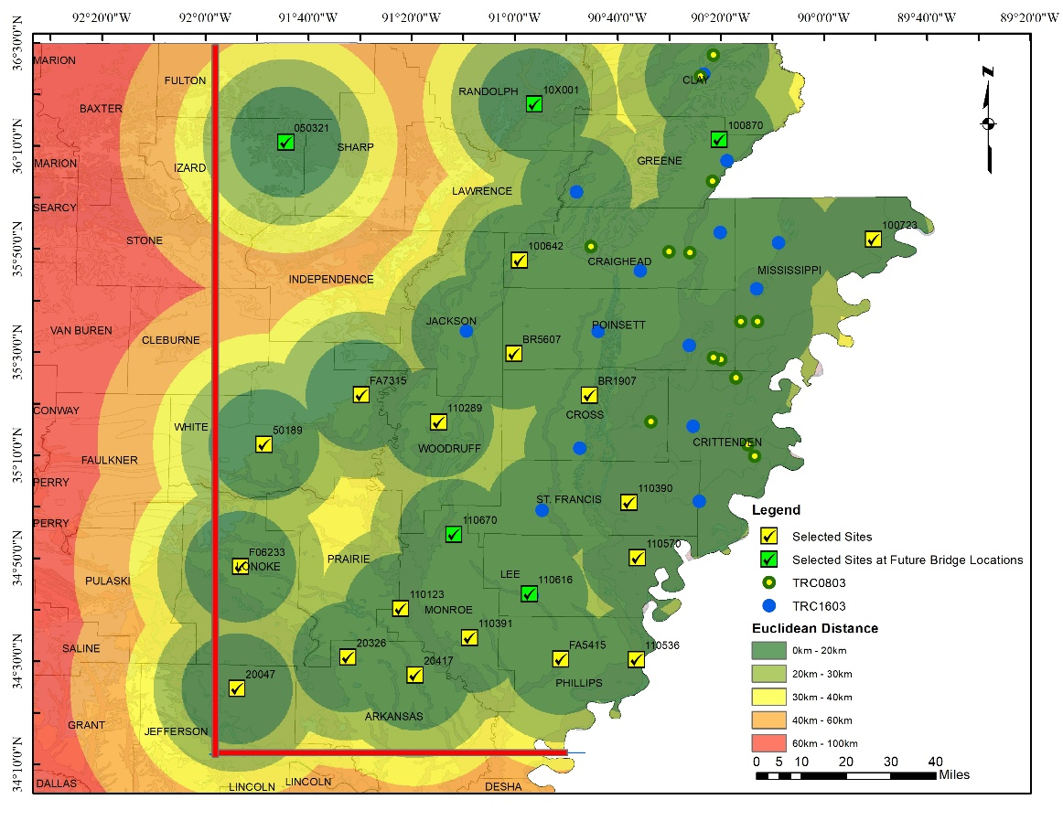
Area coverage
Notes:
Euclidean distance of available data and proposed site locations on the study area.

Slide 17
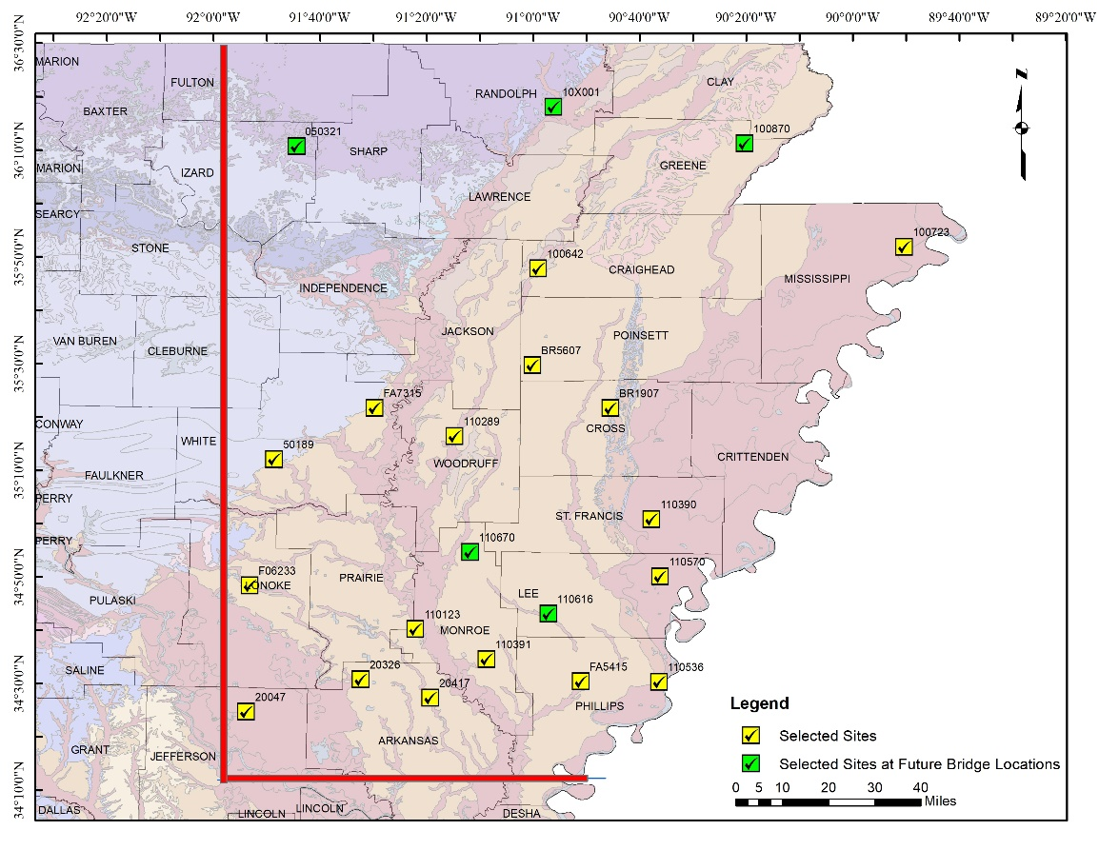
20 Selected Sites

Slide 18
Introduction
Shear wave velocity can be obtained using invasive or non-invasive techniques.
Non-invasive techniques include active and passive surface seismic methods such as
  Multi-channel Analysis of Surface Waves (MASW),
  Refraction Microtremor (ReMi)
Vertical variation of mechanical properties of the medium are estimated from spectral variation of phase velocities through the inversion of dispersion curves.

Slide 19
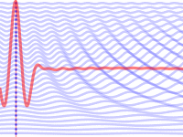
MASW
Wave generation of a principal vertical ground motion using either an impulsive (hammer) or a continuous (shaker) sources;
Recording the received signals by spectrum analyzers, seismographs, or a computer controlled by a program using special software;
Spectral analysis of the recorded time series data which results to the development of dispersion curve; that is the curve of variation of phase velocity (Raleigh wave velocity) with frequency (or wavelength); and
Inversion of dispersion curves to estimate the shear-wave velocity-depth profiles.
Notes:
Our array: 72 geophones spaced at 2 meters and 8 meter offset. 3 shots per locations throughout half of the spread.
Source: Hammer
Phase Velocity :The phase velocity of a wave is the rate at which the phase of the wave propagates in space. This is the velocity at which the phase of any one frequency component of the wave travels.
*** BLUE DOTTED LINE IN ANIMATION IS THE PHASE VELOCITY!!! Each frequency is related to a phase velocity.
The RED LINE IS THE GROUP VELOCITY

Slide 20
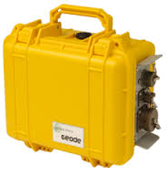
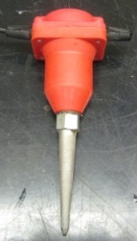
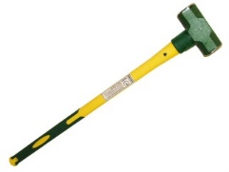
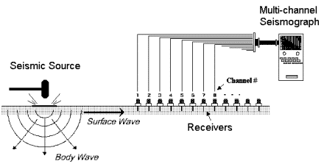
Equipment for Testing Procedure for MASW
MASW (Multi-channel Analysis of Surface Waves)
  Vertical Geophones (4.5 Hz)
  Uniform 2 meter Spacing
  Sledge Hammer
  Geodes (Data acquisition devices)
20

Slide 21
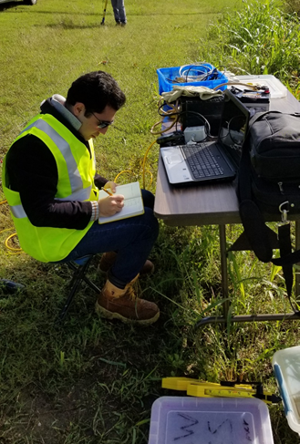
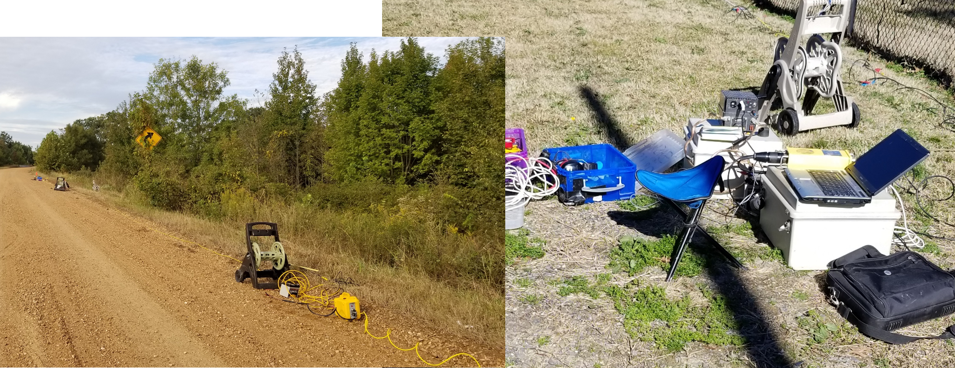
MASW field work

Slide 22
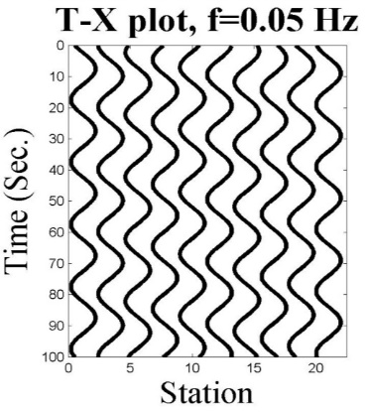
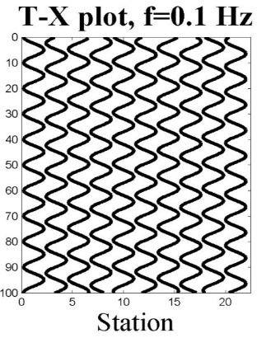
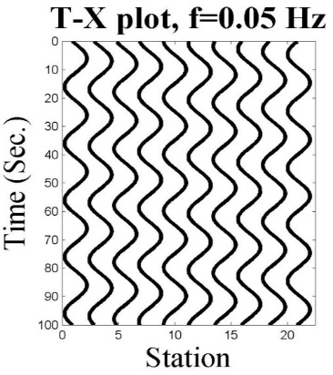
Dispersion Curve!
Heterogeneity : Source for Dispersion
Homogeneous Half Space
VR
Frequency
]
Heterogeneous Half Space
VR
Frequency
Notes:
*** dispersion curve; that is the curve of variation of phase velocity (Raleigh wave velocity) with frequency (or wavelength)
*** Dispersion curve is a graph of phase velocity versus frequency. If the soil profile changes properties as we go deeper, the dispersion curve will not be constant as a function of frequency.
If soil is homogeneous, then the dispersion curve is flat.
If the soil is non-homogenous, then sloe of T-X curves change and the phase velocities will be different for different frequencies.

Slide 23
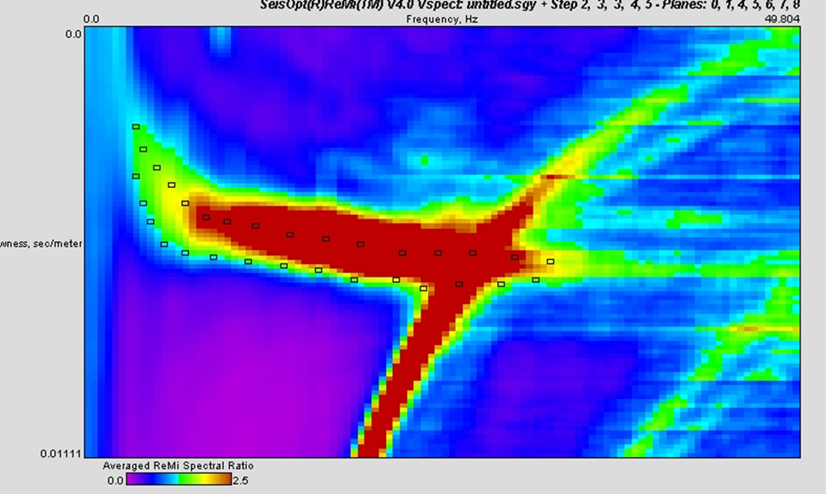
ReMi
Trying to improve the accuracy of the experimental dispersion curve in low frequencies, we use the refraction microtremor (ReMi) passive method.
The ReMi procedure uses ambient noise to determine the experimental dispersion curve in the low frequency range.
Notes:
ReMi is a passive source non-invasive test.
It captures the background noise and uses t-p transform to obtain dispersion curves.
Frequency range is the same as MASW.
But Low frequency range may be better captured using ReMi.

Slide 24
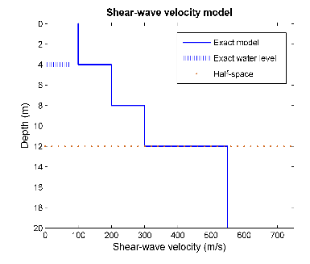
Composite Dispersion Curve
High frequency dispersion controls shallow depths and low frequencies control deeper depths.
Therefore, ReMi alone does not provide as good resolution for shallower depths which has the most influence on the site response analysis.
MASW
Notes:
Low frequency of the dispersion curve controls deeper part of the soil profile
High frequency of the dispersion curve controls the shallow part of the soil profile

Slide 25
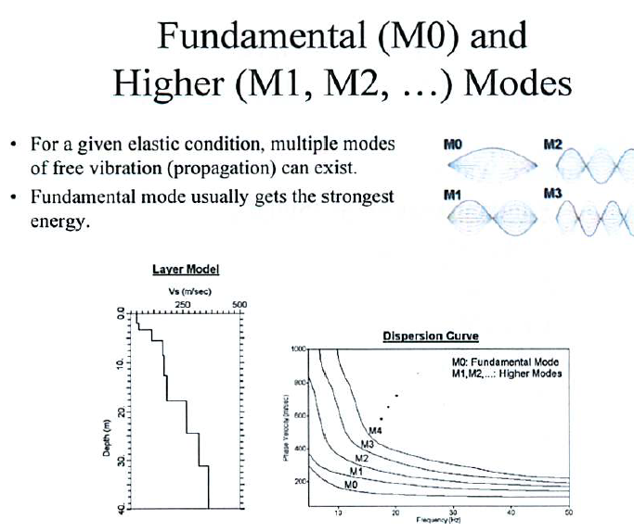
Higher Modes
If higher modes are not considered, there may be inaccurate estimation of shear-wave velocity profile, especially for cases that one may encounter of having soft soil layer(s).
Typical ReMi inversion does not consider higher modes which will may result in inaccurate determination of soil profile.
Notes:
Dispersion curves can have more than one mode. This graph shows a dispersion curve for two modes. The lower part the mode 1 and the higher red part represents the second mode.

Slide 26
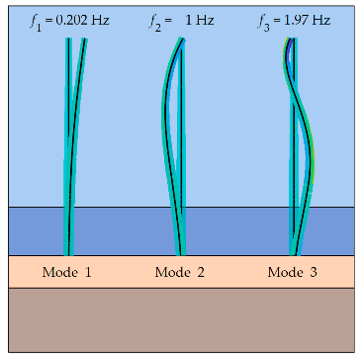
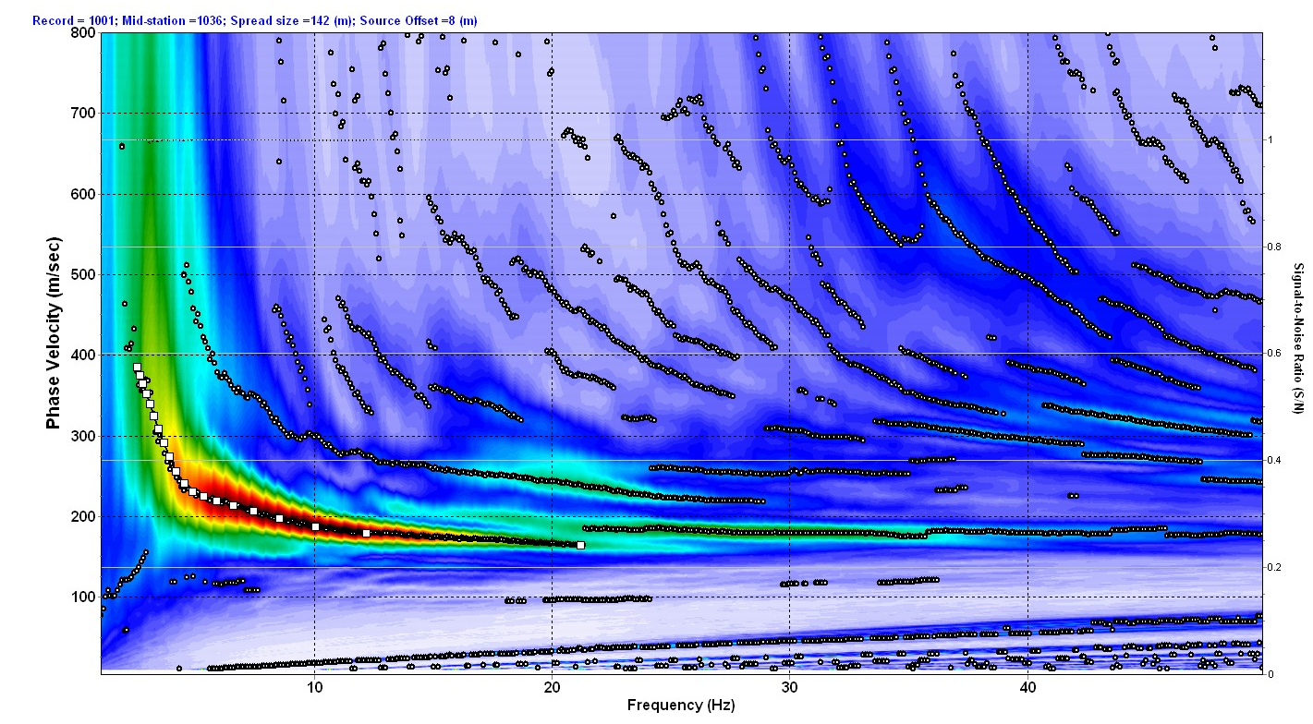
Example Dispersion Curve
Mode 2
Mode 1
Notes:
Mode 1 and Mode 2 look like figure on the top right hand corner. Also, the line shown on the dispersion curve shows mode 1 and mode 2 which result in soil shaking which looks like the figure on the top right side.
Uniqueness = When we do inversion, we come up with a shear-wave velocity soil profile and using the profile we can calculate the dispersion curve. This is called the theoretical dispersion curve. The dispersion shown above is the experimental dispersion curve and we find it from ReMi and MASW. If the theoretical and the experimental dispersion curves match we have a soil profile that we can use. But, this is a not a unique solution. We can come up with several profiles that have the same dispersion curve. By using higher modes, we can identify the best profile that has theoretical dispersion curves for modes 1 and 2 that match the experimental curve. This will reduce uncertainty.
The dispersion curve for site 4
The white dots are the dispersion curve picks from the fundamental mode.
A second mode above it is observed and implemented in inversion process to reduces non-uniqueness and uncertainty of the answer

Slide 27
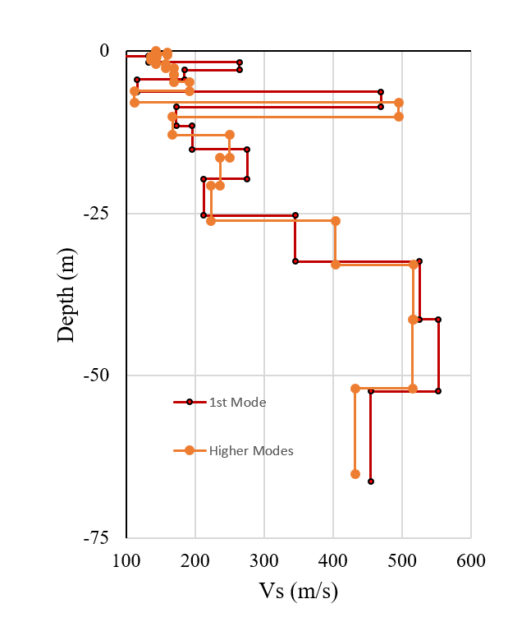
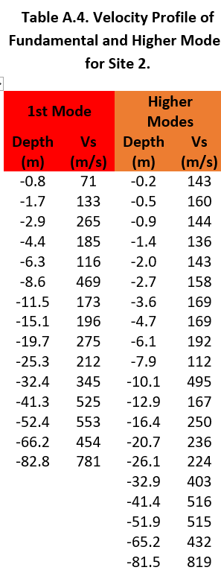
Shear-Wave Velocity Obtained from Inversion of MASW and
ReMi
Notes:
If we observed and confirmed a higher mode, we used it in inversion.
The red velocity table and profile comes from fundamental mode inversion
The orange velocity table and profile belongs to multi-mode inversion.

Slide 28
Results for 14 sites

Slide 29
Future Work
PGA, 0.2 s, and 1.0 s contour maps based on site-specific ground motion response analysis (SSGMRA)
Contour map of PGA, 0.2 s, and 1.0 s based on AASHTO,
Contour map of the difference between SSGMRA and the code-based PGA values at the ground surface, and
An estimate of cost saving or increase in the cost if SSGMRA is performed based on item “a” above and the information provided in literature.

Slide 30
Input Parameters
Longitude and latitude of the study region
Shear wave velocity profile
Soil Types
G/Gmax and Damping curves
Acceleration Time Series

Slide 31
Uniform Hazard Spectra
Site Response Analysis

Slide 32
Random Soil Profiles

Slide 33
Calculating Spectral Parameters (AASHTO General Procedure)
Determine spectral accelerations including PGA, SAs, and SA1
  Use USGS Unified Hazard Tool to download hazard curves
  B/C boundary
  1000 year return period
Determine Site Factors Fpga, Fa, and Fv
  Table 3.10.3.1-1 of ASSHTO
  PGA, SAs, and SA1 determined from previous step
  Site class based on the VS30
Multiply spectral ordinates by their relevant site factor to compute spectral parameters including As, SDs, and SD1

Slide 34
Calculating Spectral Parameters (AASHTO Site-Specific Procedure )
Calculating hazard curve on reference site condition (USGS unified hazard tool)
Development of the probability density function of amplification factors
  Development of the input motion (Source, Path, and Site terms)
  Development of base-case shear-wave velocity profiles: extend shallow portion of the velocity profiles to deeper geologic units using USGS 3D velocity model for central US.
  Determine Layer densities from the shear-wave velocity
  Randomizing shear-wave velocity profiles
  Nonlinear Dynamic Material Properties: consider two sets of generic modulus reduction and hysteretic damping to characterize the epistemic uncertainty in nonlinear dynamic material properties.
Calculating hazard curve on soil surface

Slide 35
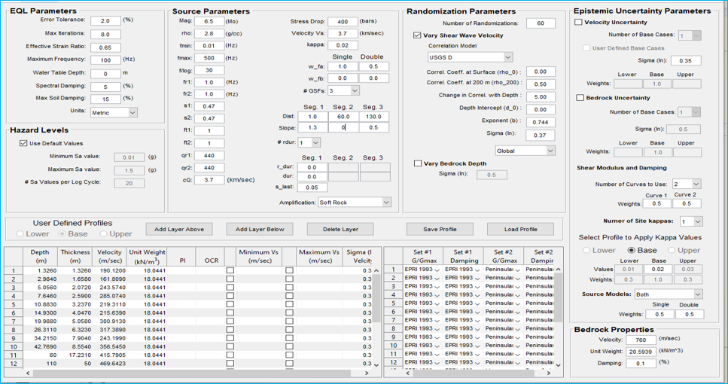

Slide 36
Acknowledgment
We would like to thank ARDOT System Information and Research Division for sponsoring this research. Special thanks to Ms. Kimberly Romano, ARDOT project coordinator, for all her help and support.

Slide 37
Thank you for your attention
Questions?

